Slide 1

WORD ANALYSIS
JOB INTERVIEWS PROJECT
?TEXT_MINING
Beyond the Questions
Analyzing Interview Data for
Strategic Preparation
Team 5
21900707 YOUNGWOO CHO
22200022 Jiho Kang
22200130 Yewon Kim

Slide 2






ANALYZING INTERVIEW DATA FOR STRATEGIC PREPARATION
TEXT_MINING
1
DATA SEARCHING
2
DATA EXPLORATION
3
DATA PREPROCESSING
6
NETWORK ANALYSIS
5
TF-IDF
4
LDA & STM

Slide 3
Data Source

Slide 4

1
DATA SOURCE
TEXT_MINING
DATE: 2022
Type: json
Number of data: 67,307
Institution name
: ㈜사람과숲, ㈜넥스인테크놀로지
Description: Convert voice to text of job interview questions and answers and summarize the contents

Slide 5
Data Exploration

Slide 6
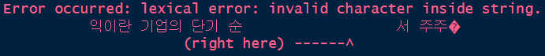
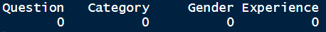

2
DATA EXPLORATION
TEXT_MINING
DATA LOADING:
Select Question, Gender, Experience data in json
Dropping 202 data due to lexical error
Check Outliers:
No outliers in data

Slide 7
2
DATA EXPLORATION
TEXT_MINING
Check Data Count Distribution:
Design | ICT | Management | PM | PublicService | RND | SalesMarketing
6469 | 5733 | 14950 | 6797 | 16745 | 4656 | 11755
Female | Male
40746 | 26359
Experienced | New
8991 | 58114
Risk of result bias due to data imbalance

Slide 8
Data Preprocessing

Slide 9
3
DATA PREPROCESSING
TEXT_MINING
Recheck Data Count Distribution:
Design | ICT | Management | PM | PublicService | RND | SalesMarketing
1341 | 1644 | 2038 | 1707 | 1843 | 1383 | 1959
Female | Male
5784 | 6131
Experienced | New
4897 | 7018
Resolving data imbalance problem
by considering all data combination
Each combination is around 500

Slide 10
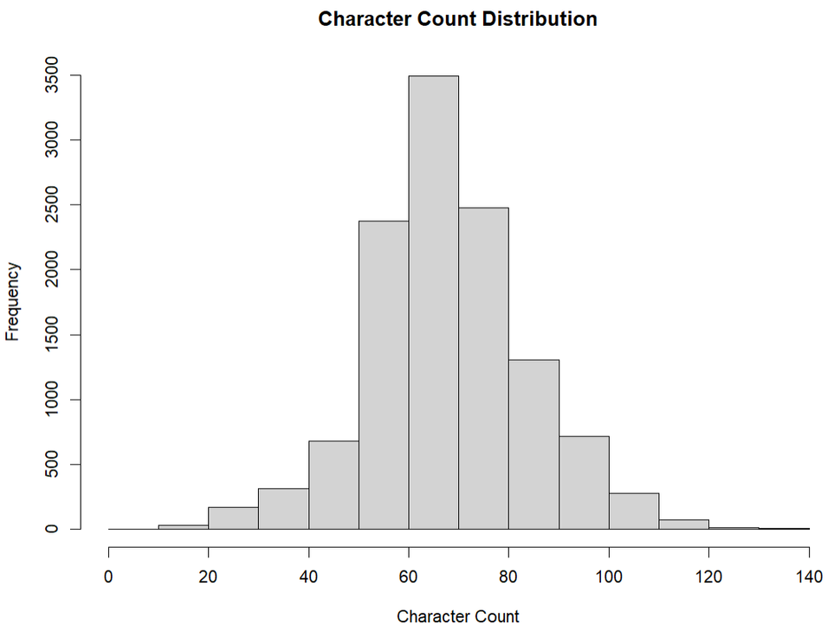
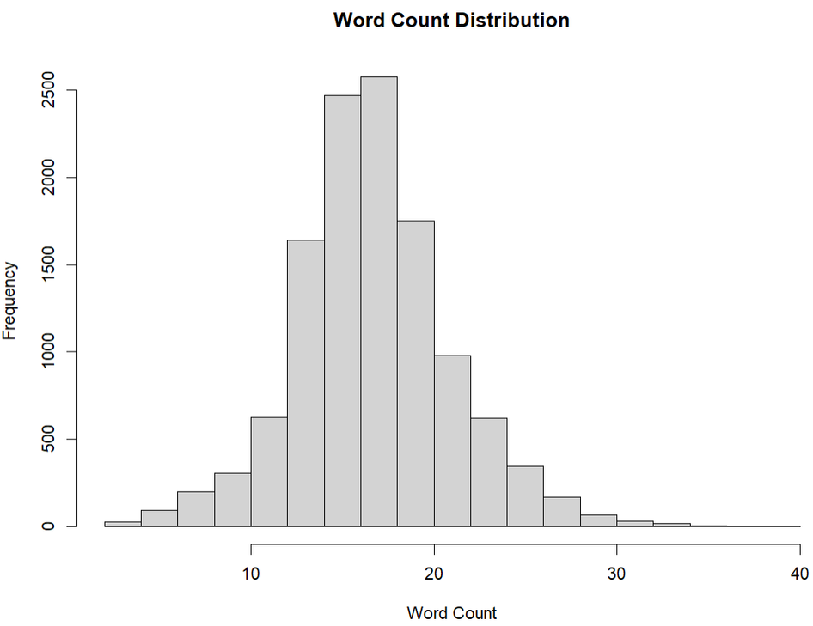
3
DATA PREPROCESSING
TEXT_MINING
Count character and word in each question

Slide 11
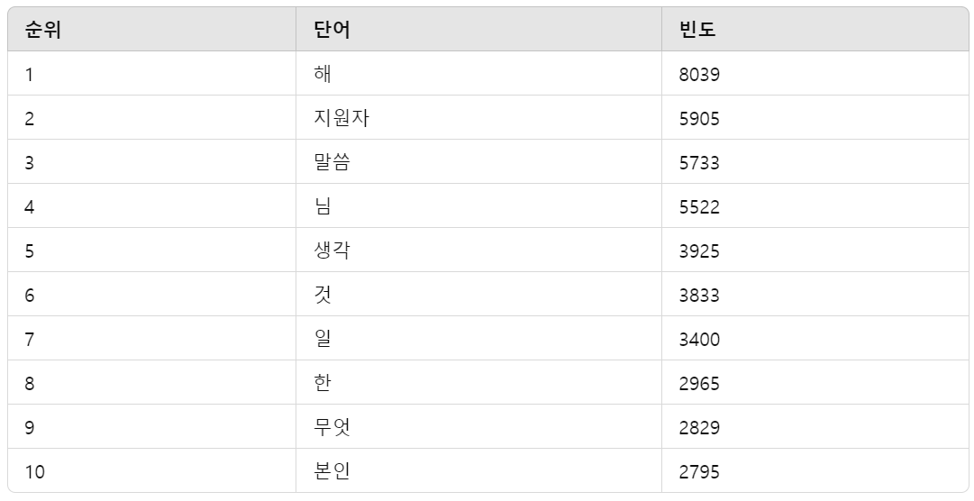
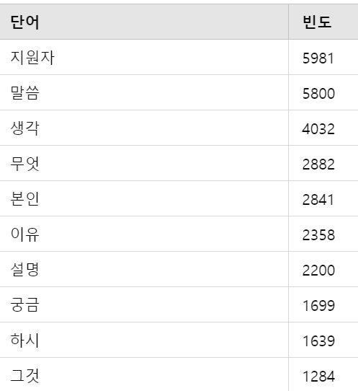
3
DATA PREPROCESSING
TEXT_MINING
Removing Stopwords
stopwords.txt,
additional words
(면접자, 지원자, 말씀, 하시...)
Delete
one letter

Slide 12
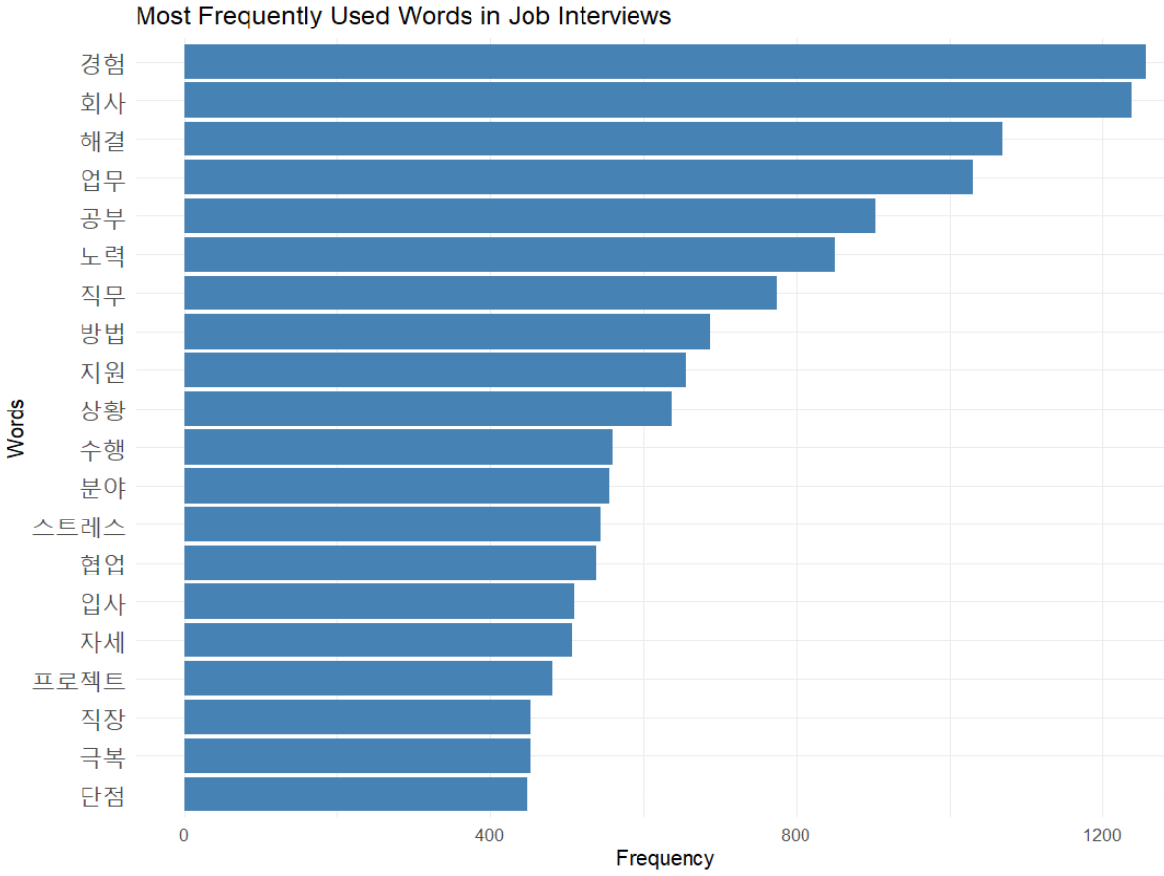
3
DATA PREPROCESSING
TEXT_MINING

Slide 13
Data Analysis

Slide 14

4
DATA ANALYSIS : LDA & STM
TEXT_MINING
Developing Interview Preparation Strategies through Question Analysis
Uncovering Hidden Topics and Evaluation Criteria with LDA and STM

Slide 15
LDA and STM
FOR IN-DEPTH ANALYSIS

Slide 16
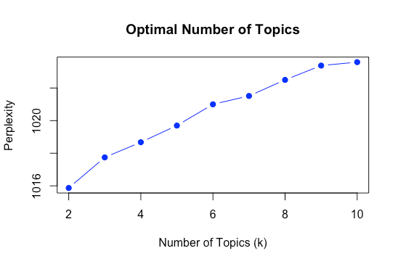
4
DATA ANALYSIS : LDA & STM
TEXT_MINING
✔️ DTM
K=2 | k=3 | k=4
topic 1 problem- solving. 'solution', 'explain’ topic 2 conversational questions. 'say', 'nowadays', ‘curious’ | topic 1 problem- solving and career related. ‘solution’, ‘experience’ topic 2 observational. ‘topic’, ‘curious’ topic 3 motivation / enthusiasm. ‘challenge’, ‘wish’, ‘passion’ | topic 1 problem- solving ‘solution’ ‘support’, ‘problem’ topic 2 conversational ‘nowadays’, ‘say’ topic 3 career and background ‘experience’, ‘resume’ topic 4 attitudes and aspirations ‘passion’, ‘challenge’, ‘wish’
✔️ K = 2 ?
Perplexity
k = 2 ~ 10

Slide 17
4
DATA ANALYSIS : LDA & STM
TEXT_MINING
K = 3 ,
Topic 1 : Problem solving and career related.
- ‘solution’ , ‘experience’.
Topic 2 : Observational.
- ‘topic’, ‘curious’.
Topic 3 : Motivation and Enthusiams.
- ‘challenge’, ‘wish’, ‘passion’.
Deep understanding of job roles.
Coping with challenges and interpersonal skills.
Stress management and achieving goals.

Slide 18

4
DATA ANALYSIS : LDA & STM
TEXT_MINING
Candidates should focus on
job fit, interpersonal skills, and stress management
during preparation.

Slide 19
THE LDA LIMITATION OF EXTRACTING TOPICS BASED SOLELY ON CO-OCCURRENCE IS SUPPLEMENTED WITH STM.
LDA and STM
FOR IN-DEPTH ANALYSIS

Slide 20
4
DATA ANALYSIS : LDA & STM
TEXT_MINING
Enables deeper analysis of
question evaluation patterns by including metadata.
✔️ Used metadata (Category, Experience, Gender)
✔️ Tested multiple k values (3~10) and selected 5.
K = 3 , 4 ( normal )
K > 5 ( too complicated )

Slide 21
4
DATA ANALYSIS : LDA & STM
TEXT_MINING
STM K=5 RESULTS
Topic 1 : Job fit and company understanding.
Topic 2 : Values and problem-solving skills.
Topic 3 : Self-motivation and goal setting.
Topic 4 : Collaboration skills.
Topic 5 : Strengths, weaknesses, and improvement plans.
Document Proportion Analysis :
Topic 1 has the highest proportion
→ Key evaluation focus.
Topic 2 has a lower proportion
→ Secondary evaluation focus.

Slide 22
4
DATA ANALYSIS : LDA & STM
?TEXT_MINING
LDA and STM’s Conclusion
Candidates should focus on key areas
such as job fit, company understanding,
and personal values.
Comprehensive preparation for
Topic1-related questions is critical.
Future Applications
Develop customized question banks by job role.
Create interview preparation guidelines.
Improve company recruitment evaluation processes.

Slide 23
TF-IDF

Slide 24
5
TF-IDF
TEXT_MINING
KEYWORD ANALYSIS BY JOB CATEGORY
KEYWORD ANALYSIS BY GENDER
KEYWORD ANALYSIS BY EXPERIENCED
TF-IDF STEP
WORD FREQUENCY CALCULATION
DELETE ADDITIONAL STOPWORD
CALCULATE TF-IDF
VISUALIZATION: TOP 10 KEYWORDS BY TF-IDF

Slide 25
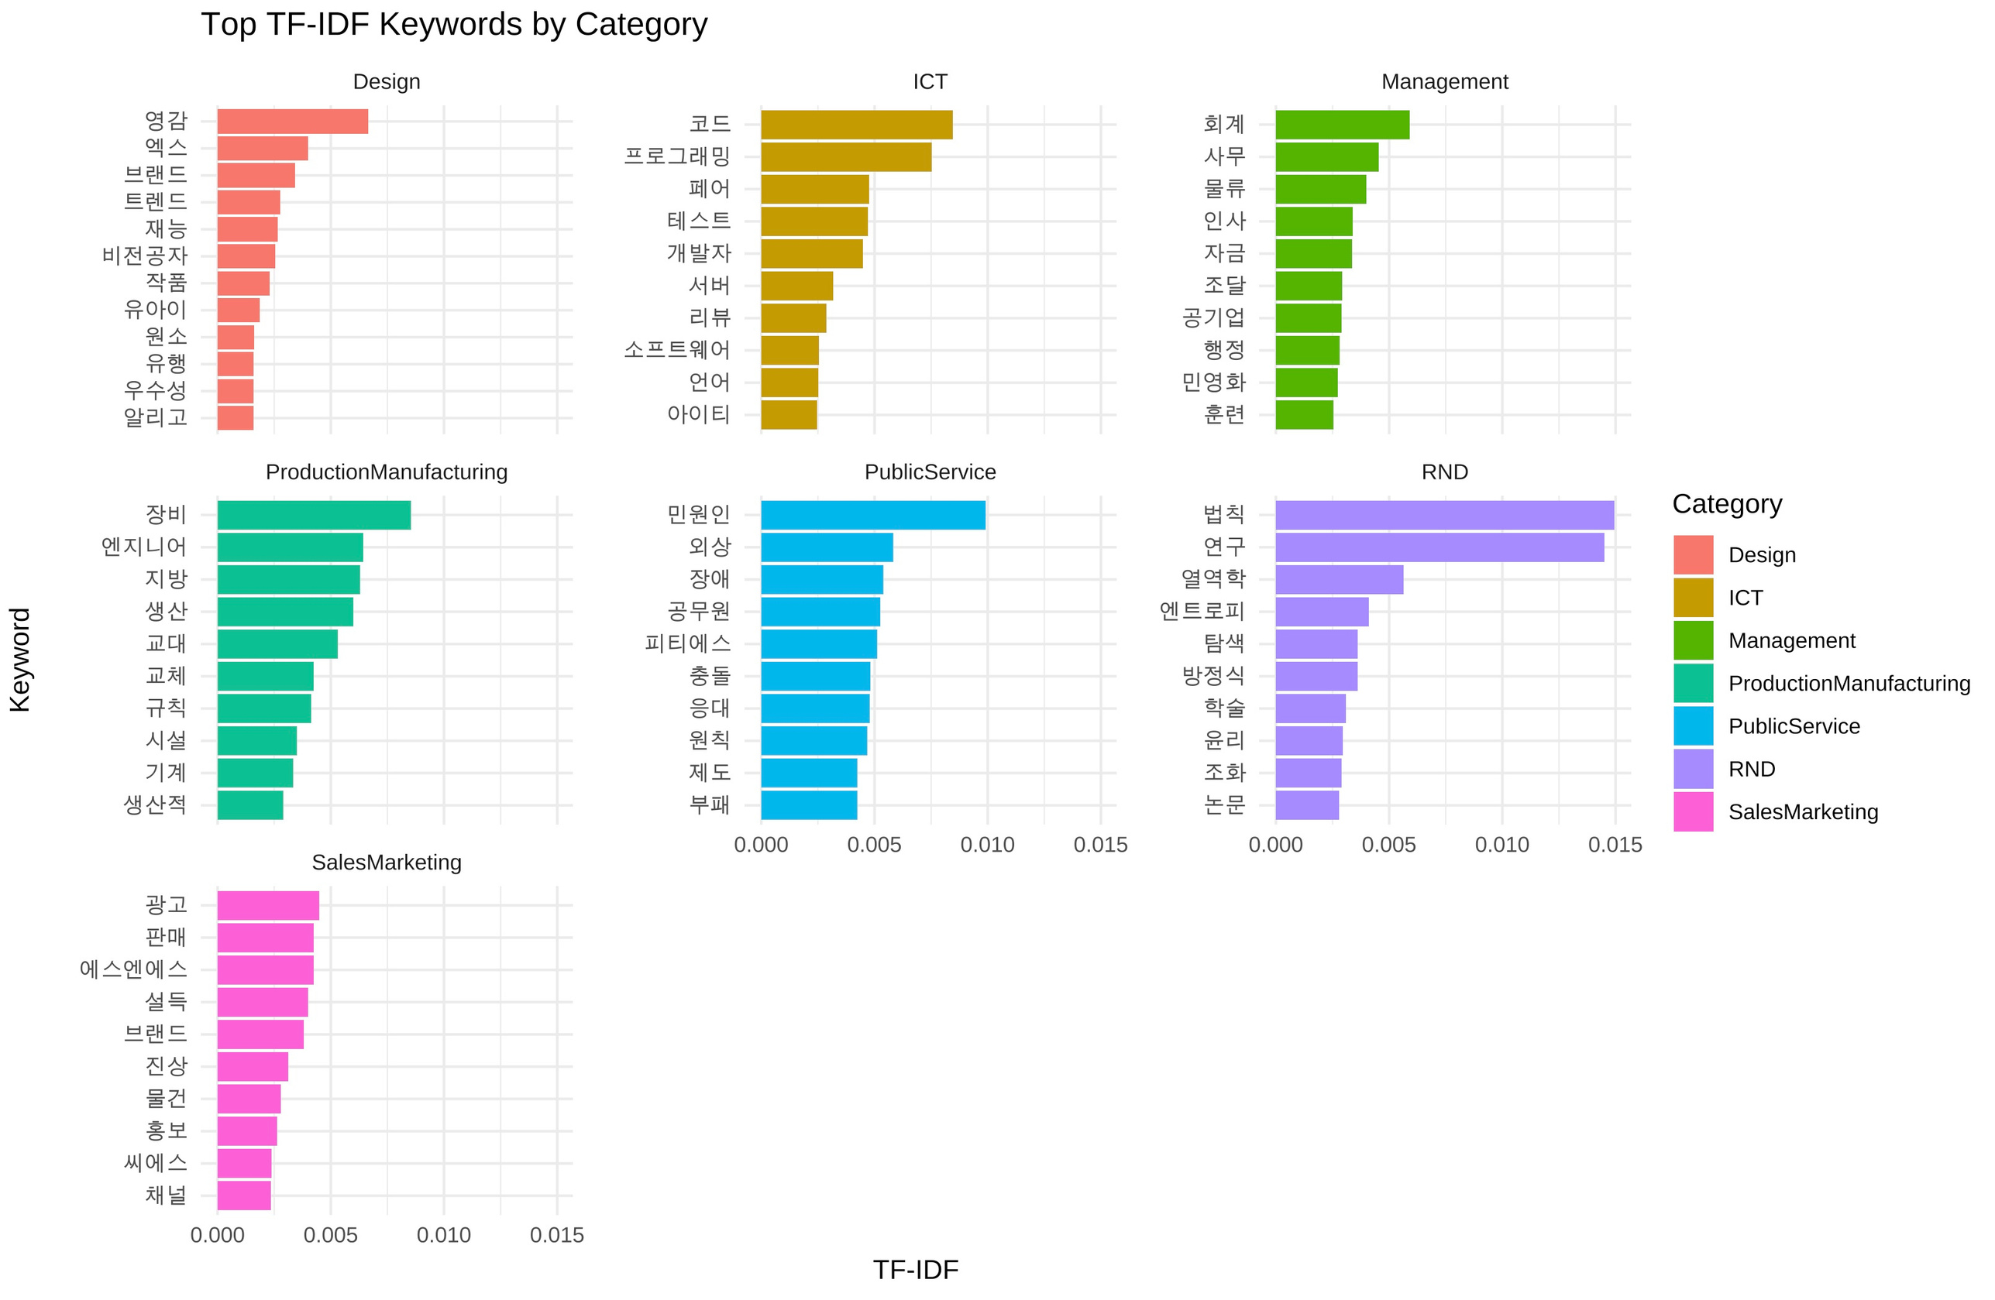
5
TF-IDF
TEXT_MINING
KEYWORD ANALYSIS BY JOB CATEGORY
keyword
TF-IDF

Slide 26
5
TF-IDF
TEXT_MINING
KEYWORD ANALYSIS BY JOB CATEGORY
keyword
TF-IDF

Slide 27
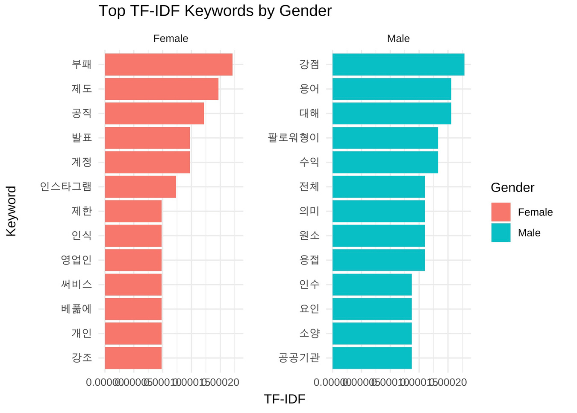
5
TF-IDF
TEXT_MINING
KEYWORD ANALYSIS BY GENDER
Female candidates can prepare to emphasize social responsibility, interpersonal skills, and digital media expertise.
Male candidates should focus on showcasing technical expertise, economic achievements, and practical problem-solving abilities.
keyword
TF-IDF

Slide 28
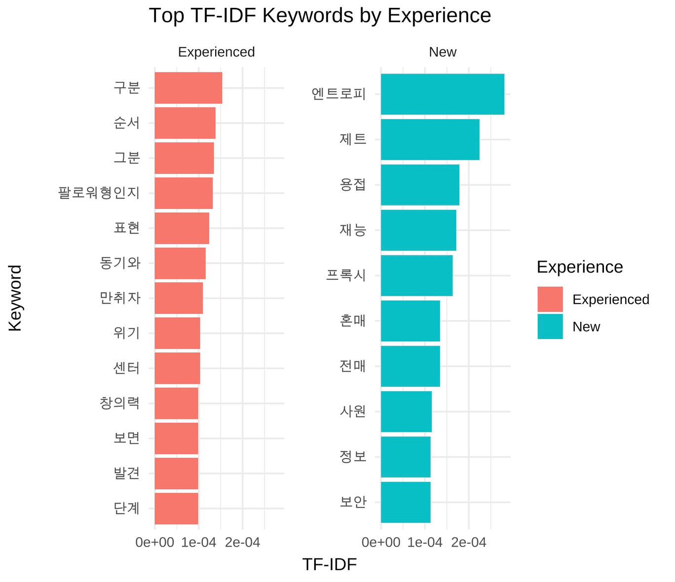
5
TF-IDF
TEXT_MINING
KEYWORD ANALYSIS BY EXPERIENCED
Experienced candidates should highlight examples of problem-solving and strengths demonstrated in real-world scenarios.
Inexperienced candidates should showcase adaptability and learning potential through relevant examples.
keyword
TF-IDF

Slide 29
Network Analysis

Slide 30
6
NETWORK ANALYSIS
TEXT_MINING
NETWORK ANALYSIS STEP
Step 1: Create Edge List
Iterating Over Pairs of Sentences
Building Edges
Step 2: Process Data for Each Category
Filtering Data
Tokenizing Text
Selecting Word Lists
Step 3: Build Networks
Step 4: Visualize Networks
Edges
Nodes
Labels

Slide 31
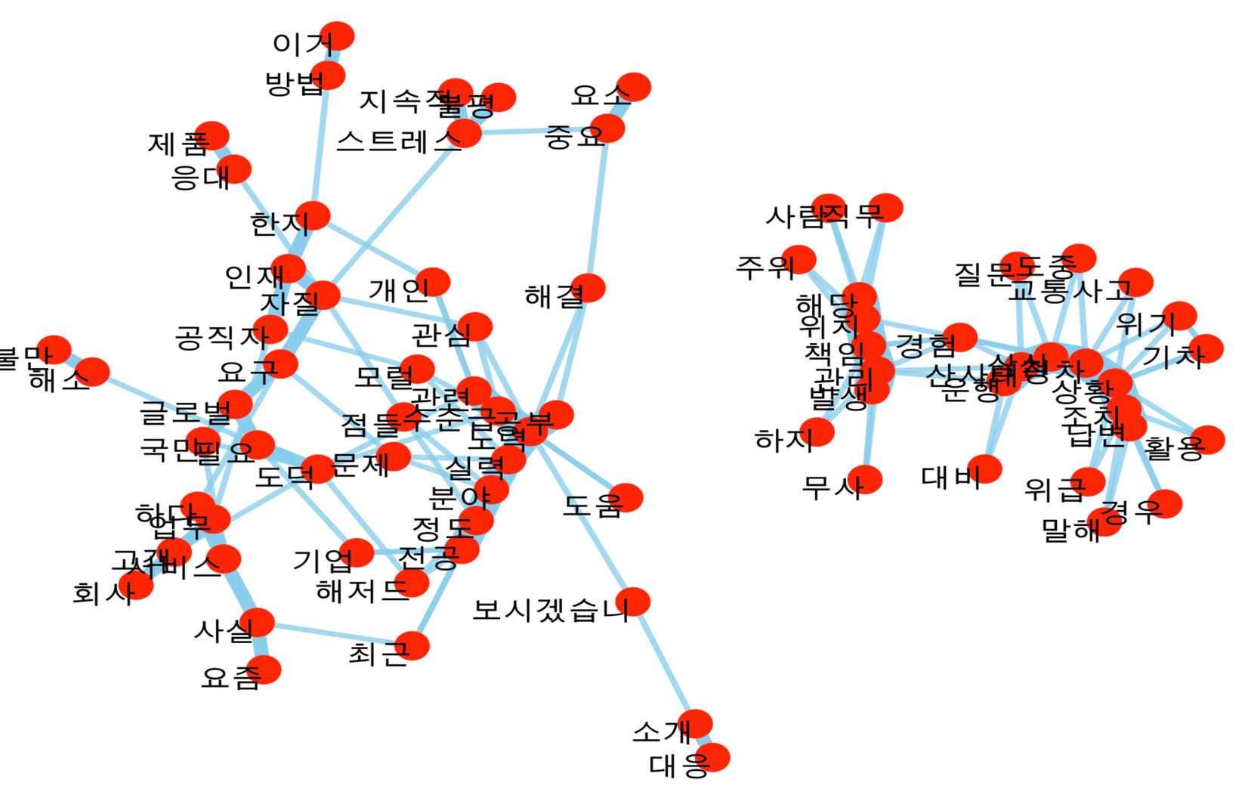

6
NETWORK ANALYSIS
TEXT_MINING
NETWORK ANALYSIS PUBLIC SERVICE
EXPECTED QUESTION
"How would you balance global standards with citize needs in public service? Can you explain how you would apply international practices while considering local context?"
->Topic1 : Job fit and company
understanding
{Public, ?Need, Global ,Citizen}

Slide 32
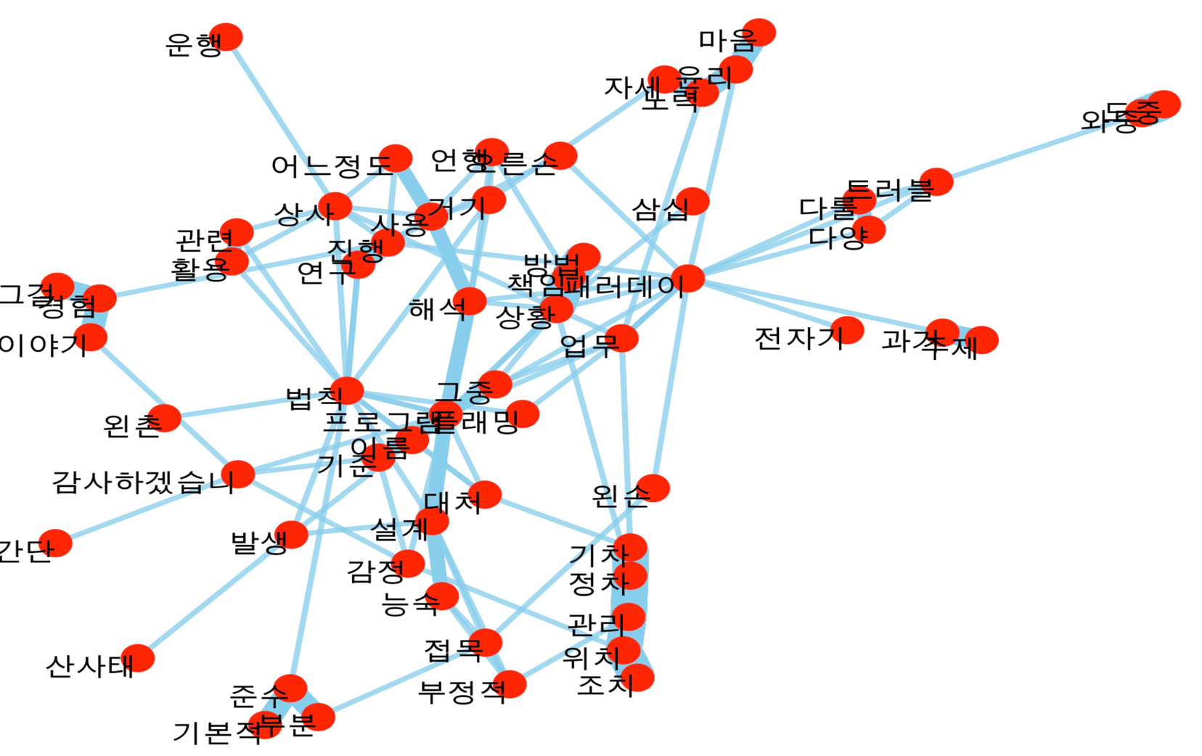

6
NETWORK ANALYSIS
TEXT_MINING
NETWORK ANALYSIS ?RND
EXPECTED QUESTION
"How have you applied fundamental principles such as Faraday’s Law or Fleming’s Laws in your work? Could you share an example where these principles were practically applied in your projects?"
->Topic 2 : Values and problem-
solving skills
{?Principle, Fleming}

Slide 33
7
CONCLUSION
TEXT_MINING
By using various analysis approaches, you can find out important interview keywords for each job type and create expected questions based on these.
While we haven’t reached the stage of generating interview questions, we were able to discover the possibility of connecting with a model that generates questions using keywords.
This will help simulate real interview situations more realistically in the future.

Slide 34
TEXT_MINING
THANK YOU

